Slide 1
The Legacy of Redlining and Segregation on Des Moines, IA
By Kendyl Landeck

Slide 2
QGIS: First Step
I started out by needing to put my ArcGIS maps that I created for my Master’s project into QGIS and export them to GeoJSON in order to put each of them on a leaflet map.

Slide 3
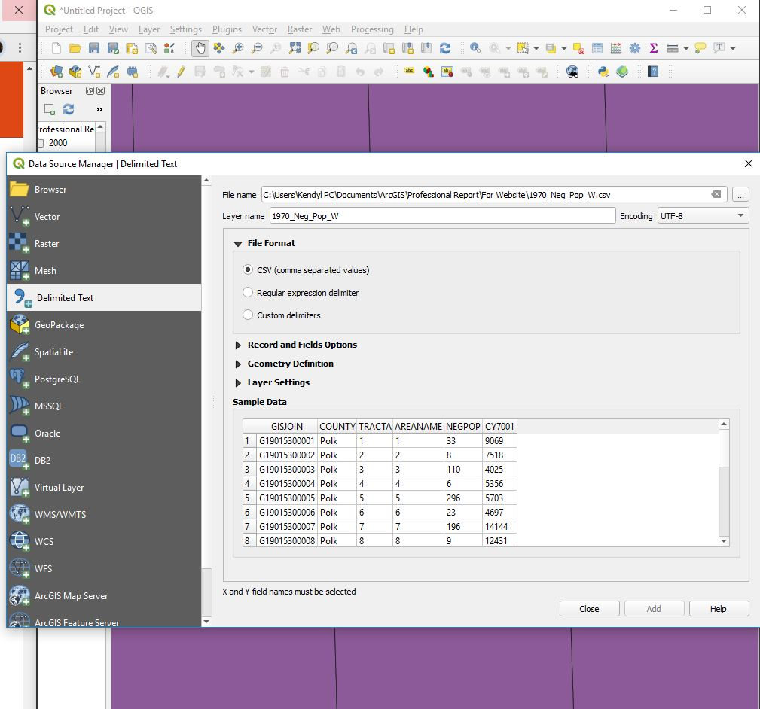
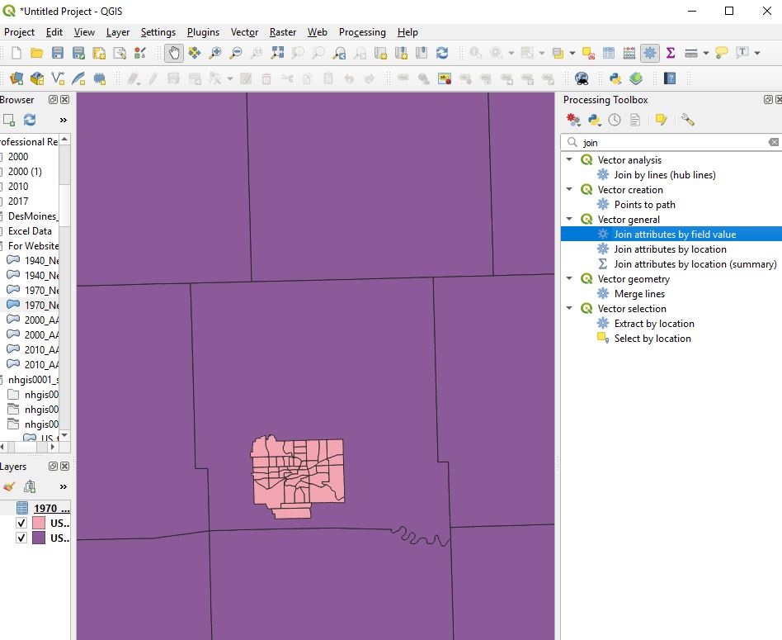
QGIS: Second Step
Then after getting my shapefiles into QGIS, I had to join some tables to the layers to make sure it was showing properly to export.

Slide 4
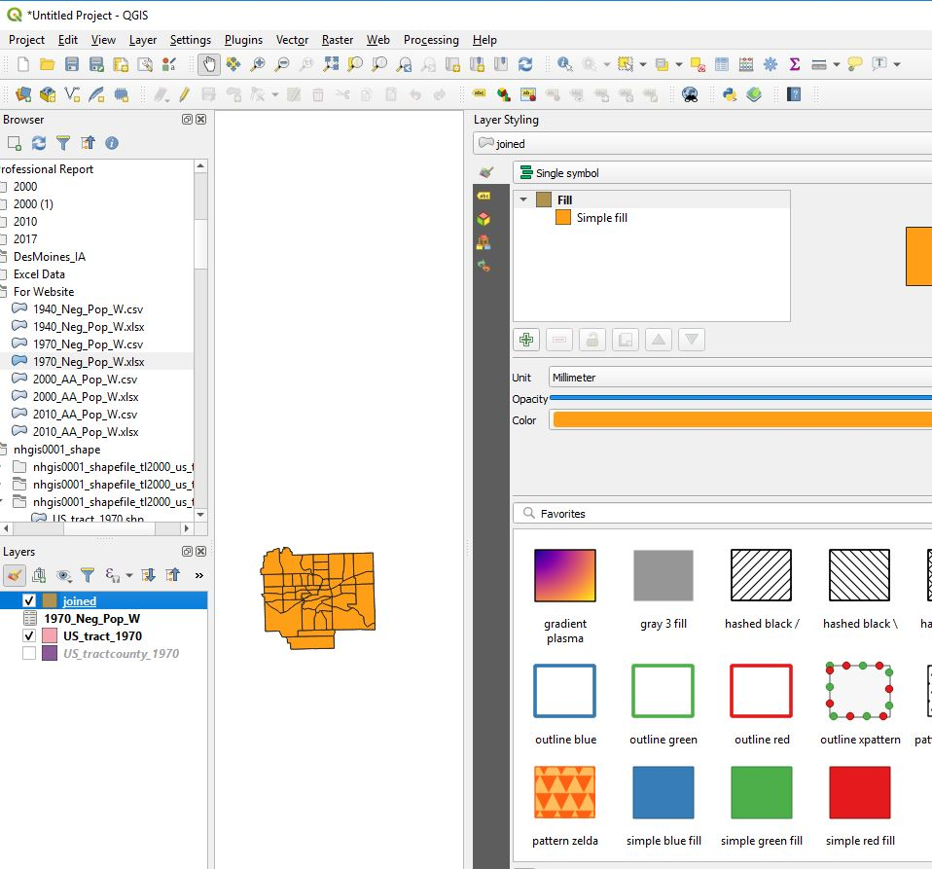
QGIS: Step Three
Then I decided to check the symbology for the joined table and layer to just make sure that when exported I would have the correct information showing when deciding on the best way to visualize the data.

Slide 5
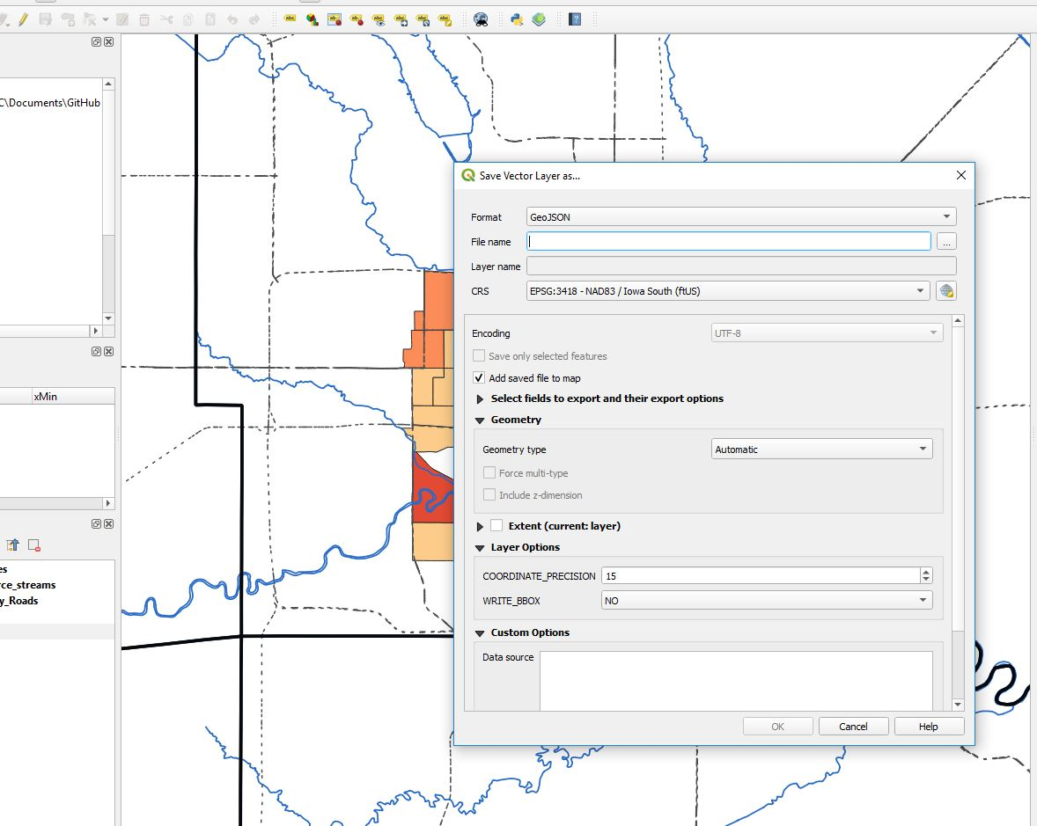
QGIS: Step Four
After completing this, the best way to export the map to be layer on a leaflet map was not the original way we learned. Instead, I needed to export the individual joined layer and export it as a single GeoJSON file that I could then use as an overlay layer in my leaflet map.

Slide 6
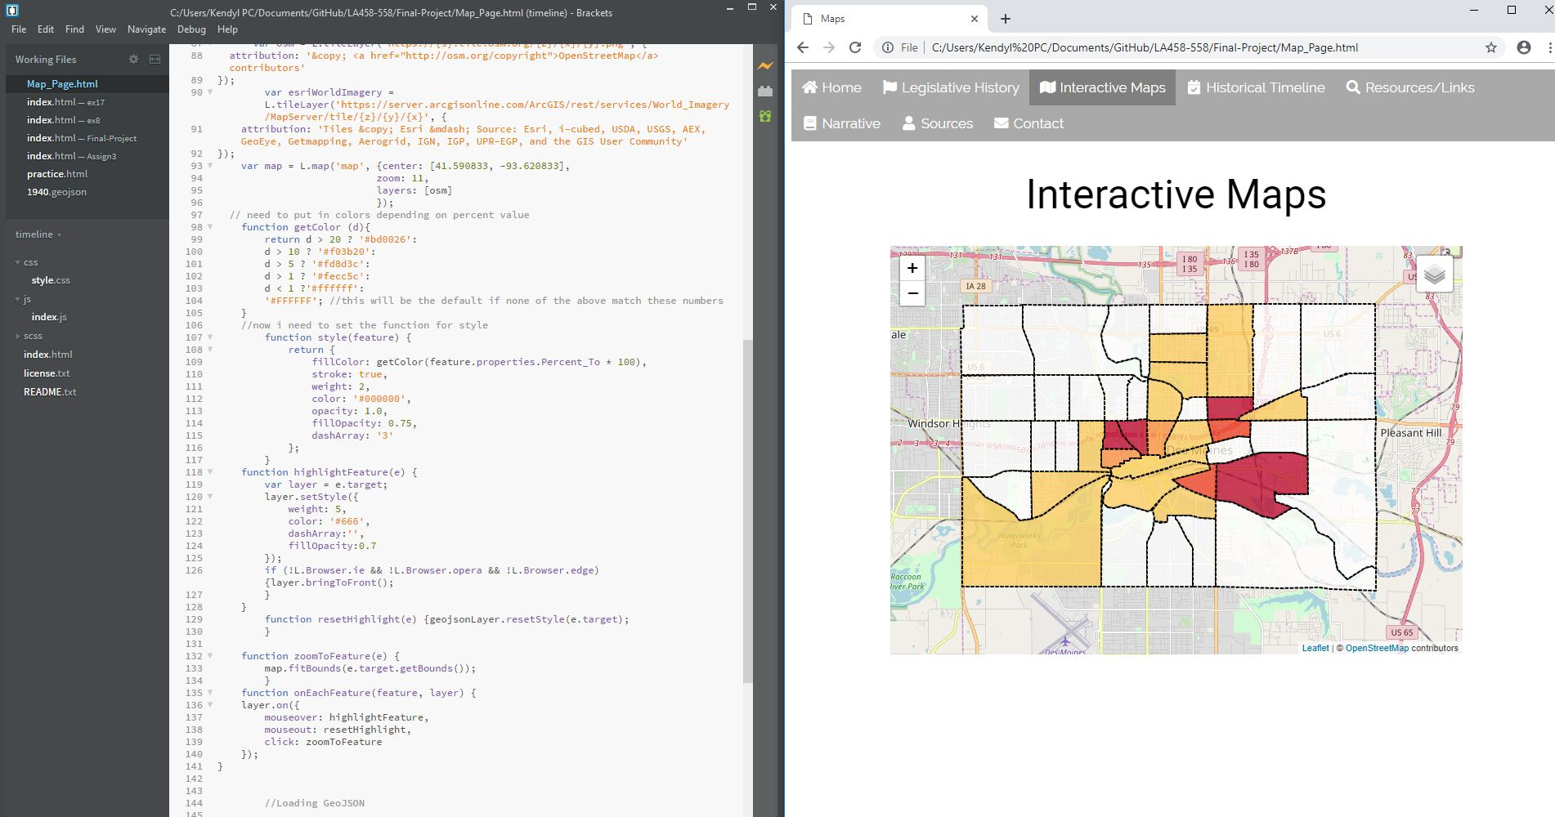
HTML, CSS, JS: Step Five
After exporting, I then needed to use the AJAX function we learned about to bring in my GeoJSON layers (4 of them) and create colors that would work well together.

Slide 7
HTML, CSS, JS: Step Six
After getting on all the layers, Professor Seeger helped me trouble shoot a few issues with the layers and we were unable to figure out the tooltip or popup for each separate layer. So that will need to be a thing I figure out next.

Slide 8
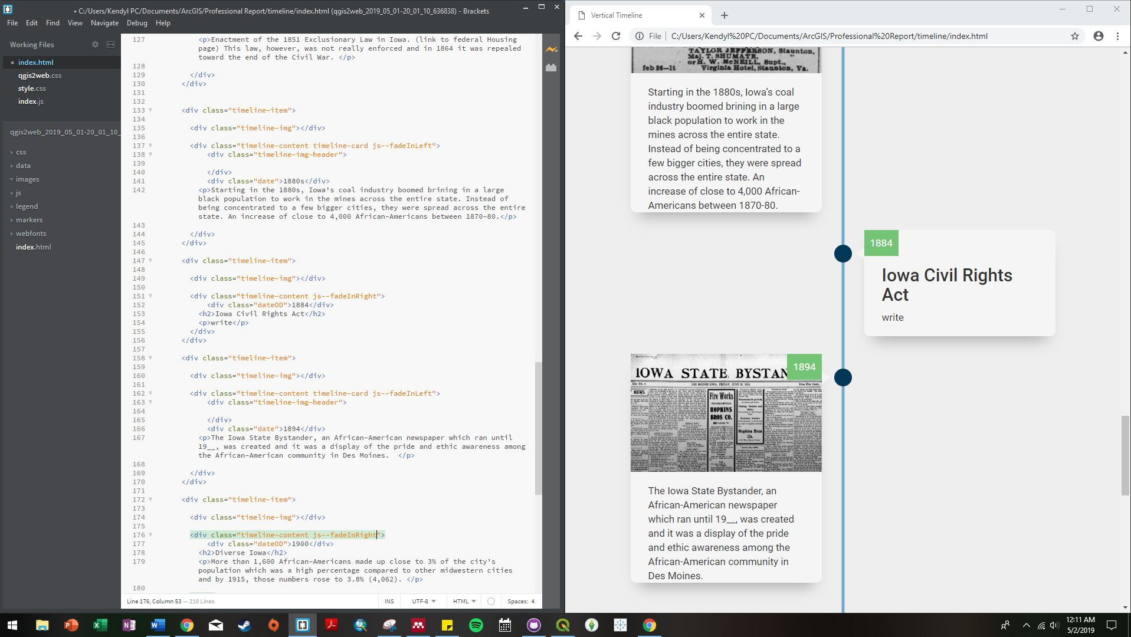
HTML, CSS, JS: Step Seven
For another section of my webpage, I wanted to make a timeline that would be interesting to the eye. So I went online and found a cool template that was easy to follow and taught me more about divs and classes.

Slide 9
HTML, CSS, JS: Step Eight
I trouble shooted a lot with the different boxes, colors and images. The floating in js was interesting to figure out when first trying to understand what each part of the timeline template meant.

Slide 10
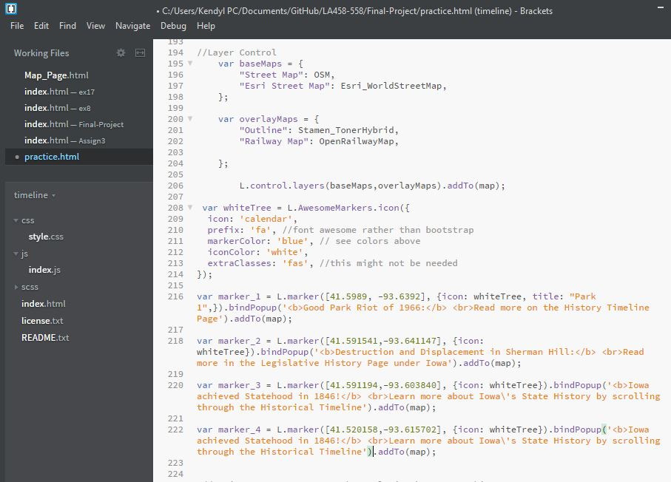
HTML, CSS, JS: Step Nine
After figuring out what I needed to on the timeline, I wanted to create another leaflet map that was part of the introduction to my website.
I decided to use awesome markers with popups to create an interactive map to provide information about the website itself and important information.

Slide 11
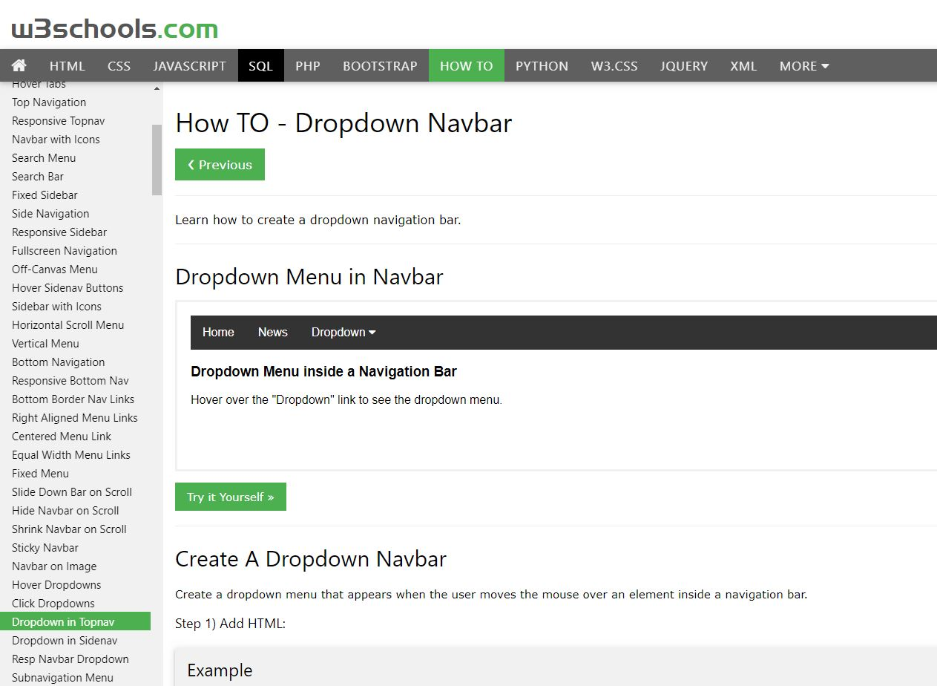
HTML, CSS, JS: Step Ten
I wanted the website to have more of a “real” look and have links that could help provide flow for the website.
I decided to add a Navigation Bar to the website, which Professor Seeger helped me figure out some of the issues that go along with having multiple pages needing to be loaded. That is why he provided that information about jQuery and movement in one document instead of across many.

Slide 12
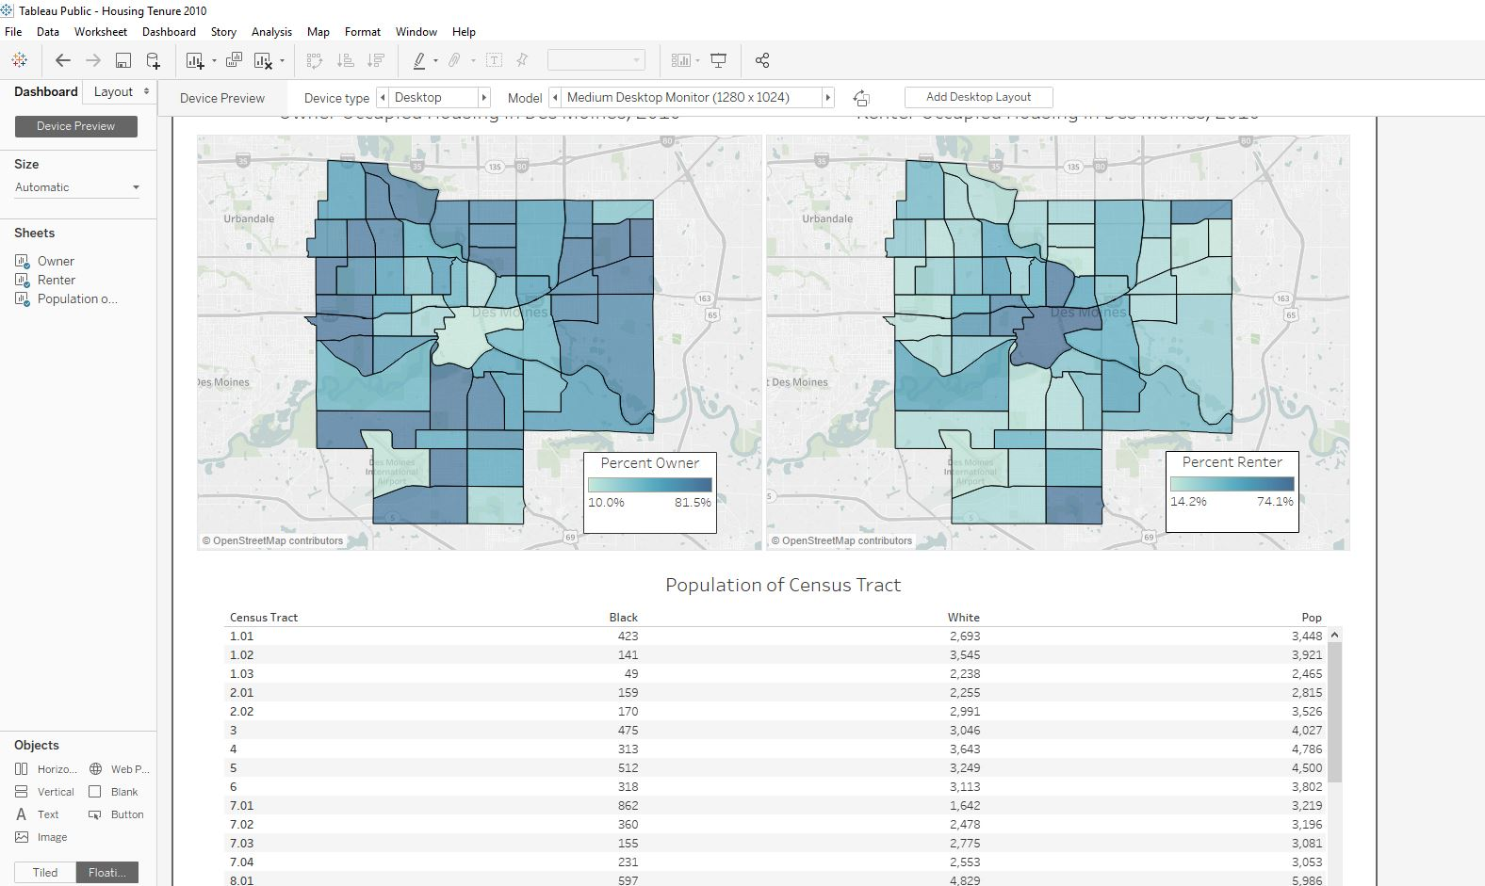
Tableau: Step Eleven
I wanted to learn more about Tableau and the ways it could be used.
I decided to use census data to make maps and tables to show percent owner and renter in the census tracts from my other Leaflet maps.
I had some hard times trying to figure out how to spatial files into Tableau that were not points but polygons, but after reading some information on line, I was able to find the solution and it was successful.

Slide 13
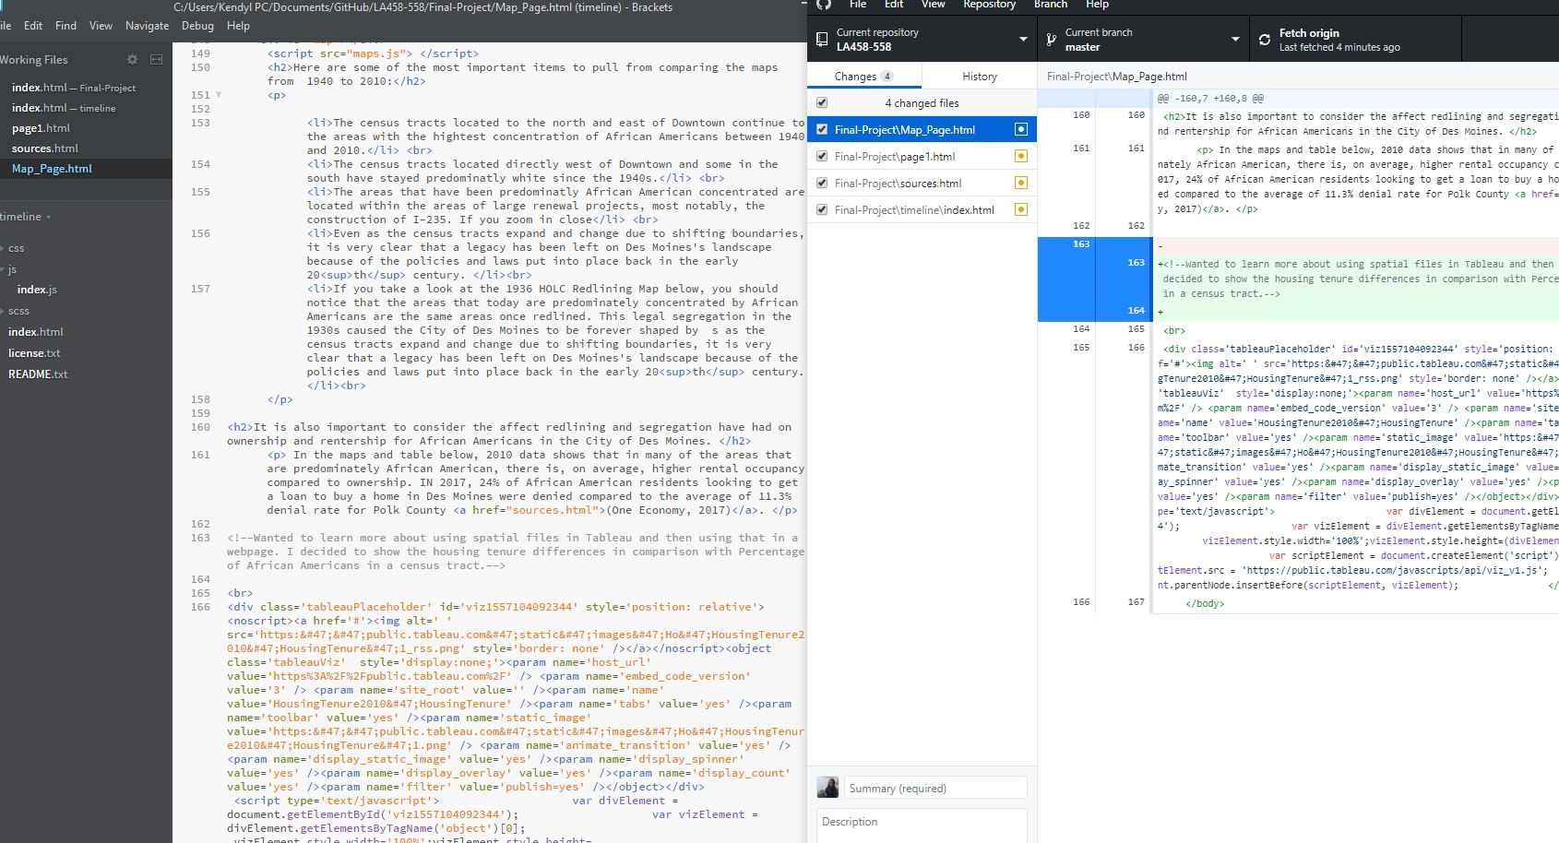
Tableau: Step Twelve
After some trouble shooting and working through all the little details and adding all of my data/text (which you can see there is a lot of) I put all of these separate pieces together to create my webpage.

Slide 14
Step Thirteen
This project was extremely fun and satisfying as I learned many different little details in HTML, JS, CSS, Tableau and QGIS that helped me bring together my entire project.
As you can tell, this is part of a larger project. The final product for my Master’s Project is actually this coding and the creation of a functioning website for people to use. While there may be some problems right now with the layers not loading correctly the second time going to the page, I am working to fix that so that when I present on May 17, I can provide a good example of this product.
If you read my Overview, you will get a very good sense about what my project is all about!!!

